Slide 1
EA Workshop Feedback

Slide 2
Professional Body ESOS Assessment Data
Professional Body | Active Lead Assessors |  | No. ESOS Assessments |  | Av. per Lead Assessor
 | no. | % of total | no. | % of total
CIBSE | 269 | 35 | 2,324 | 34 | 9
EI | 187 | 24 | 2,064 | 30 | 11
AEE | 85 | 11 | 519 | 8 | 6
EMA | 65 | 8 | 454 | 7 | 7
Stroma | 39 | 5 | 514 | 8 | 13
Elmhurst | 36 | 5 | 248 | 4 | 7
ICE | 32 | 4 | 168 | 2 | 5
IEMA | 25 | 3 | 200 | 3 | 8
Quidos | 17 | 2 | 179 | 3 | 11
NES | 8 | 1 | 77 | 1 | 10
ECMK | 7 | 1 | 54 | 1 | 8
IES | 2 | 0.3 | 14 | 0.2 | 7
Total | 772 | 100 | 6,815 | 100 | 8

Slide 3
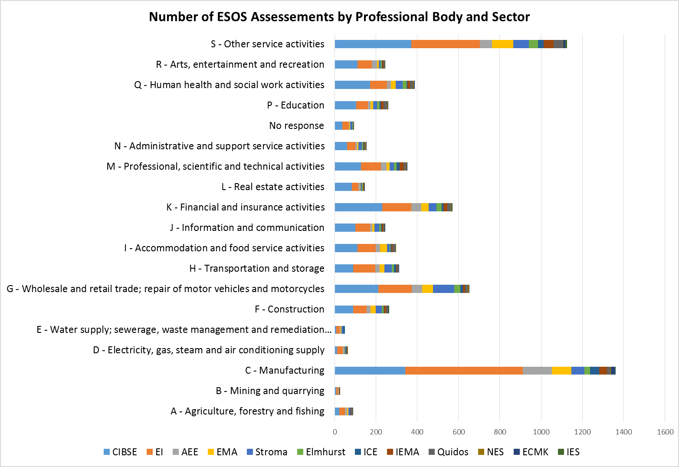

Slide 4
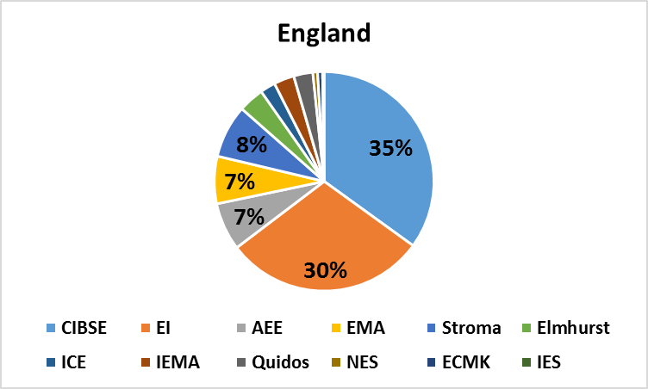
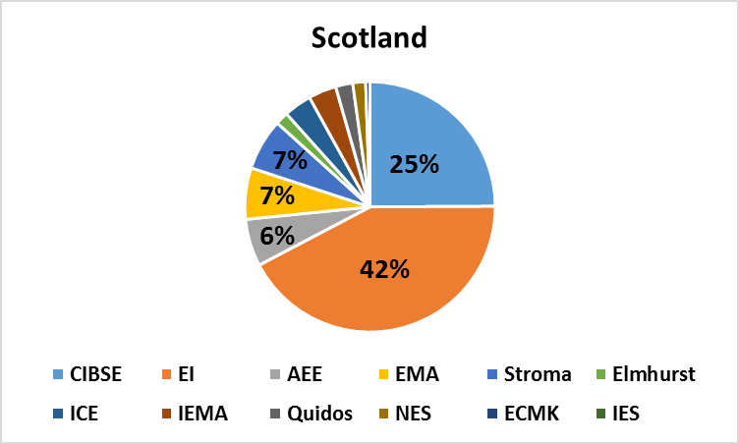
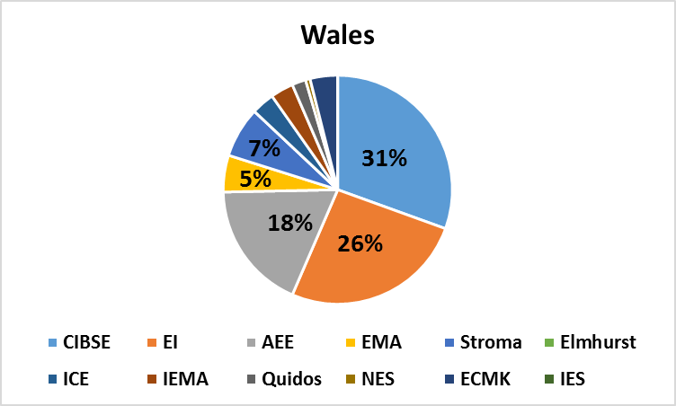
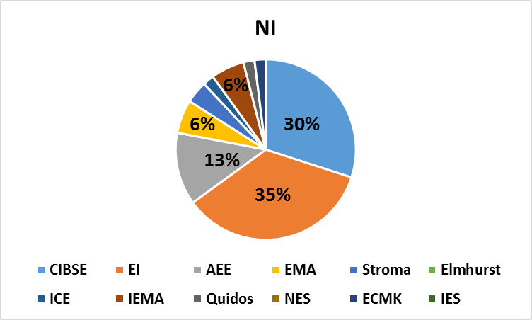
% of ESOS Assessments by PB and Country

Slide 5
% of ESOS Assessments by PB and Country
Professional Body | Country
 | England | Wales | Scotland | NI | Offshore
CIBSE | 2,120 | 47 | 90 | 30 | 4
EI | 1,800 | 40 | 153 | 35 | 6
AEE | 427 | 28 | 22 | 13 | 2
EMA | 424 | 8 | 24 | 6 | 1
Stroma | 473 | 11 | 24 | 4 | 1
Elmhurst | 229 | 0 | 6 | 0 | 0
ICE | 136 | 5 | 13 | 2 | 1
IEMA | 182 | 5 | 13 | 6 | 2
Quidos | 171 | 3 | 8 | 2 | 0
NES | 42 | 1 | 6 | 0 | 0
ECMK | 44 | 6 | 2 | 2 | 0
IES | 14 | 0 | 0 | 0 | 0
Total | 6,062 | 154 | 361 | 100 | 17

